Slide 1
1
Unit 2
PROJECT PLANNING AND MANAGEMENT

Slide 2


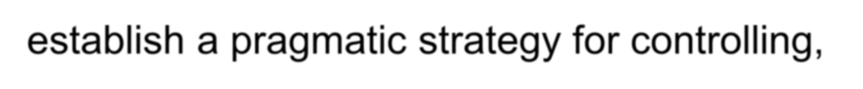
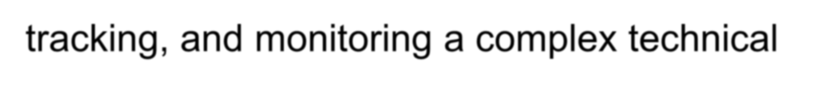
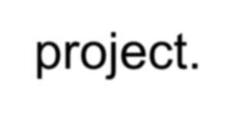



Software Project Planning
2

Slide 3
Project Planning Task Set-I
3
◆ Establish project scope
◆ Determine feasibility
◆ Analyze risks
◆ Risk analysis is considered in detail in Chapter 25.
◆ Define required resources
◆ Determine require human resources
◆ Define reusable software resources
◆ Identify environmental resources

Slide 4
Project Planning Task Set-II
4
◆ Estimate cost and effort
◆ Decompose the problem
◆ Develop two or more estimates using size, function points, process tasks or use-cases
◆ Reconcile the estimates
◆ Develop a project schedule
◆ Scheduling is considered in detail in Chapter 27.
◆ Establish a meaningful task set
◆ Define a task network
◆ Use scheduling tools to develop a timeline chart
◆ Define schedule tracking mechanisms

Slide 5
Estimation
5
◆ Estimation of resources, cost, and schedule for a software engineering effort requires
◆ experience
◆ access to good historical information (metrics)
◆ the courage to commit to quantitative predictions when qualitative information is all that exists
◆ Estimation carries inherent risk and this risk leads to uncertainty

Slide 6











Write it Down!
6
Software Project Plan
Project Scope Estimates Risks Schedule
Control strategy

Slide 7


To Understand Scope ...
7
◆ Understand the customers needs
◆ understand the business context
◆ understand the project boundaries
◆ understand the customer’s motivation
◆ understand the likely paths for change
◆ understand that ...

Slide 8
What is Scope?
8
◆ Software scope describes
◆ the functions and features that are to be delivered to end-users
◆ the data that are input and output
◆ the “content” that is presented to users as a consequence of using the software
◆ the performance, constraints, interfaces, and reliability that bound the system.
◆ Scope is defined using one of two techniques:
◆ A narrative description of software scope is developed after
communication with all stakeholders.
◆ A set of use-cases is developed by end-users.

Slide 9
Resources
9
number
software tools
skills
hardware
people
environment
network resources
location
project
reusable software
OTS
new
components
components
full-experience components
part.-experience components

Slide 10
Four characteristics of Resources
Each resource is specified with four characteristics:
Description of the resource,
Statement of availability,
Time when the resource will be required, and
Duration of time that the resource will be applied.
The last two characteristics can be viewed as a time window.

Slide 11
Reusable Software Resources
Bennatan [Ben00] suggests four software resource categories that should be considered as planning proceeds:
Off-the-shelf components. Existing software that can be acquired from a third party or from a past project.
COTS (commercial off-the-shelf) components are purchased from a third party, are ready for use on the current project, and have been fully validated.
Full-experience components. Existing specifications, designs, code, or test data developed for past projects that are similar to the software to be built for the current project. Members of the current software team have had full experience in the application area represented by these components. Therefore, modifications required for full-experience components will be relatively low risk.

Slide 12
Reusable Software Resources
Partial-experience components. Existing specifications, designs, code, or test data developed for past projects that are related to the software to be built for the current project but will require substantial modification.
Members of the current software team have only limited experience in the application area represented by these components.
Therefore, modifications required for partial-experience components have a fair degree of risk.

Slide 13
Reusable Software Resources
New components. Software components must be built by the software team specifically for the needs of the current project.

Slide 14
Environmental Resources
The environment that supports a software project, often called the software engineering environment (SEE), incorporates hardware and software.

Slide 15

Project Estimation
10
◆ Project scope must be understood
◆ Elaboration (decomposition)
is necessary
◆ Historical metrics are very helpful
◆ At least two different
techniques should be used
◆ Uncertainty is inherent in the process

Slide 16
DECOMPOSITION TECHNIQUES
Decomposition approach was discussed from two different points of view:
Decomposition of the problem and
Decomposition of the process.
Software Sizing
- The accuracy of a software project estimate is predicated on a number of things:
(1) The degree to which you have properly estimated the size of the product to be built;
The ability to translate the size estimate into human effort, calendar time, and dollars (a function of the availability of reliable software metrics from past projects);
The degree to which the project plan reflects the abilities of the software team;
The stability of product requirements and the environment that supports the software engineering effort.

Slide 17
How do we size the software that we’re planning to build?
Putnam and Myers [Put92] suggest four different approaches to the sizing problem:

Slide 18

Estimation Techniques
11
◆ Past (similar) project experience
◆ Conventional estimation techniques
◆ task breakdown and effort estimates
◆ size (e.g., FP) estimates
◆ Empirical models
◆ Automated tools

Slide 19
Estimation Accuracy
12
◆ Predicated on …
◆ the degree to which the planner has properly estimated the size of the product to be built
◆ the ability to translate the size estimate into human effort, calendar time, and dollars (a function of the availability of reliable software metrics from past projects)
◆ the degree to which the project plan reflects the abilities of the software team
◆ the stability of product requirements and the environment that supports the software engineering effort.

Slide 20








Functional Decomposition
13
Statement of
Scope
functional decomposition
Perform a
Grammatical “parse”

Slide 21
Conventional Methods: LOC/FP Approach
14
◆ compute LOC/FP using estimates of information
domain values
◆ use historical data to build estimates for the project

Slide 22
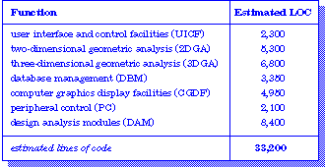


Example: LOC Approach
15
Average productivity for systems of this type = 620 LOC/pm.
Burdened labor rate =$8000 per month, the cost per line of code is approximately $13.
Based on the LOC estimate and the historical productivity data, the total estimated project cost is $431,000 and the estimated effort is 54 person-months.

Slide 23
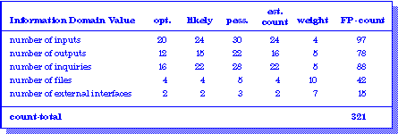













Example: FP Approach
16
The estimated number of FP is derived:
FP_{estimated} = count-total 3 [0.65 + 0.01 3 S (F_{i})]
^{FP}estimated ⁼ ³⁷⁵ organizational average productivity = 6.5 FP/pm.
burdened labor rate = $8000 per month, approximately $1230/FP.
Based on the FP estimate and the historical productivity data, total estimated project cost is $461,000 and estimated effort is 58 person-months.

Slide 24






Process-Based Estimation
17
Obtained from “process framework”
 | framework activities
application functions | Effort required to accomplish each framework activity for each
 | application function

Slide 25

Process-Based Estimation Example
18
Activity | CC | Planning | Risk Analysis | Engineering |  | Construction Release |  | CE | Totals
Task |  |  |  | analysis | design | code | test
Function
UICF |  |  |  | 0.50 | 2.50 | 0.40 | 5.00 | n/a | 8.40
2DGA |  |  |  | 0.75 | 4.00 | 0.60 | 2.00 | n/a | 7.35
3DGA |  |  |  | 0.50 | 4.00 | 1.00 | 3.00 | n/a | 8.50
CGDF |  |  |  | 0.50 | 3.00 | 1.00 | 1.50 | n/a | 6.00
DSM |  |  |  | 0.50 | 3.00 | 0.75 | 1.50 | n/a | 5.75
PCF |  |  |  | 0.25 | 2.00 | 0.50 | 1.50 | n/a | 4.25
DAM |  |  |  | 0.50 | 2.00 | 0.50 | 2.00 | n/a | 5.00
Totals | 0.25 | 0.25 | 0.25 | 3.50 | 20.50 | 4.50 | 16.50 |  | 46.00
% effort | 1% | 1% | 1% | 8% | 45% | 10% | 36%
CC = customer communication CE = customer evaluation
Based on an average burdened labor rate of $8,000 per month, the total estimated project cost is $368,000 and
person-months.

Slide 26





Tool-Based Estimation
19
project characteristics
calibration factors LOC/FP data

Slide 27

Estimation with Use-Cases
20
use cases scenarios pages 6
10
5
К | scenarios | pages | LOC
К | 12 | 5 | 560
К | 16 | 8 | 3100
К | 10 | 6 | 1650
К | К | К | К
К | К | К | К
LOC estimate
3,366
31,233
7,970
User interface subsystem Engineering subsystem group Infrastructure subsystem group
Total LOC estimate
10
20
6
6
8
5
e subsystem
subsystem group e subsystem group
stimate
42,568
Using 620 LOC/pm as the average productivity for systems of this type and a burdened labor rate of $8000 per month, the cost per line of code is approximately $13. Based on the use- case estimate and the historical productivity data, the total estimated project cost is $552,000 and the estimated effort is 68 person-months.

Slide 28
















Empirical Estimation Models
21
General form:
exponent
effort = tuning coefficient * size
usually derived
as person-months of effort required
empirically derived
usually LOC but may also be function point
either a constant or
a number derived based on complexity of project

Slide 29
COCOMO-II
22
◆ COCOMO II is actually a hierarchy of estimation models that address the following areas:
◆ Application composition model. Used during the early stages of software engineering, when prototyping of user interfaces, consideration of software and system interaction, assessment of performance, and evaluation of technology maturity are paramount.
◆ Early design stage model. Used once requirements have been stabilized and basic software architecture has been established.
◆ Post-architecture-stage model. Used during the construction
of the software.

Slide 30



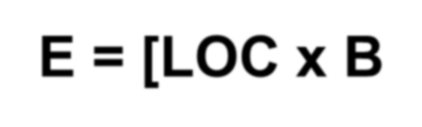

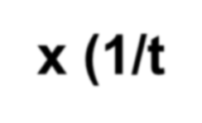
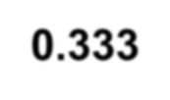











The Software Equation
23
A dynamic multivariable model
E = [LOC x B^{0.333}/P]³ x (1/t⁴)
where
E = effort in person-months or person-years t = project duration in months or years
B = “special skills factor”
P = “productivity parameter”

Slide 31
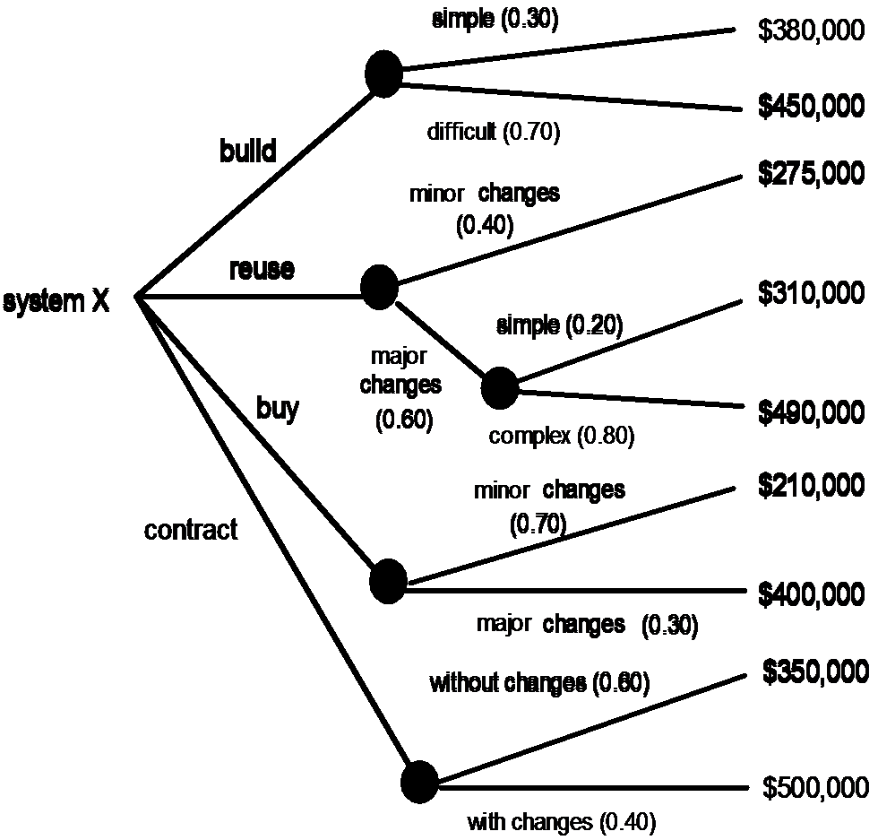
The Make-Buy Decision
24

Slide 32

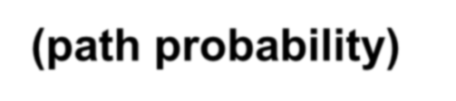
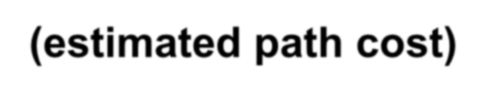





Computing Expected Cost
25
expected cost =
(path probability) x (estimated path cost)
i i
For example, the expected cost to build is:
= 0.30 ($380K) + 0.70 ($450K)
= $429 K
expected cost
build
similarly,
expected cost = $382K reuse
expected cost = $267K buy
expected cost = $410K
Cont

